Slide 1
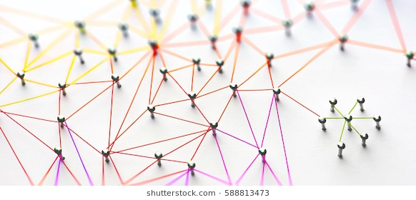
IB Physics 1 – Aug 14, 2018 – Triplett Rm 210
Welcome to IB Physics!! You choose your seat. Record on map.
Let’s find connections –
Activities
Interests
Events
Hobbies
Entertainment
Fears
Etc..

Slide 2
Some possible questions
What kind of music do you like?
Where do members of your family come from? What languages do they, and you, speak?
What holidays do you enjoy and how do you celebrate them?
If you could travel anyplace for free, where would you like to travel? Why?
What is a place that you have visited that you like the most?
Have you ever been to a park, zoo, museum, or a farm? Pick one and tell us about it
When is your birthday and where were you born?
What is a movie or a book you have seen or read lately that you really liked? Why?

Slide 3
Homework
Visit our class website.
Download the syllabus. Print and bring to next class.
(2 pt assignment) Show me the syllabus hardcopy or digital for credit.
Determine Albert’s Life Lesson for August
https://www.slps.org/Page/33379

